Slide 1
Feature Selection in R

Slide 2
What is Machine Learning?
It is a type of artificial intelligence (AI) that provides computers with the ability to learn without being explicitly programmed
It focuses on the development of computer programs that can change when exposed to new data.
Notes:
Using algorithms that iteratively learn from data, machine learning allows computers to find hidden insights without being explicitly programmed where to look
The iterative aspect of machine learning is important because as models are continuously exposed to new data, they are able to independently adapt
the ability to automatically apply complex mathematical calculations to big data – over and over, faster and faster – is a recent development
This means that it becomes extremely useful to aid the development of business globally

Slide 3
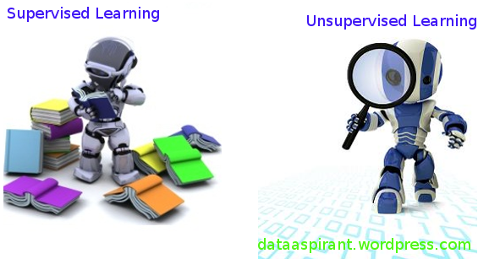
Supervised vs. Unsupervised Learning
Notes:
Supervised → has a set of input variables and a corresponding set of target variables/labelled responses
→ the targets can be expressed in the form of different classes – then it becomes a classification problem
→ or the target space can be continuous – in which case, it becomes a regression problem
Unsupervised → has only a set of input variables → one has to look for patterns in the data

Slide 4
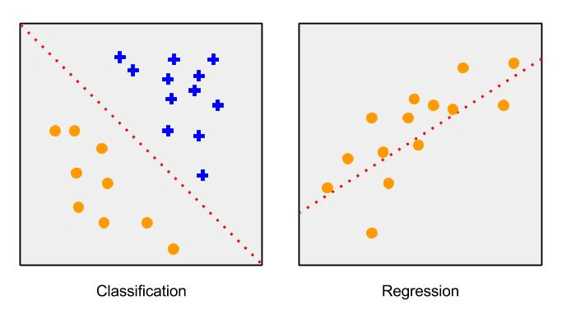
Classification vs. Regression (Supervised)
Notes:
As mentioned above:
Classification → the output variable takes on class labels – eg. Yes or No, x y z, etc.
→ we try to find the correct class label for the given input.
Regression → the output variable is continuous – eg. Projected sales for the year
→ we're trying to predict the value of a continues valued function

Slide 5
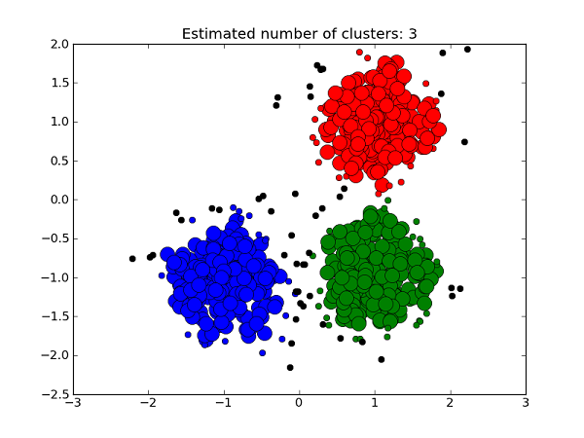
Clustering (Unsupervised)
Notes:
Clustering → Form of unsupervised learning that can find structure in a set of seemingly random (or unlabelled) data

Slide 6
Feature Selection
Filter methods
Based on statistical tests measuring some intrinsic properties of the dataset / features
information gain
chi-square test
correlation coefficient
variance threshold
Wrapper methods
recursive feature elimination
sequential feature selection algorithms
genetic algorithms
Notes:
What exactly is feature selection and why do we need it?
Raw features may be too large and redundant to be managed
As a result, we select a subset of features that most strongly influence our output
as well as create new features by combinations of other features to create a reduced set of features
The feature set is then a set of attributes that are most relevant to the predictive modelling problem that you are working on
There are many different methods by which feature selection may be achieved
Largely 2 groups of methods: Filter and Wrapper methods
Filter → Selects features
Wrapper → Tests the validity of those features

Slide 7
Filter Methods
Pearson Correlation (Using R Library)
Check if there exists multi-colinearlity between features
To eliminate redundant features

Slide 8
Wrapper – test relevance
Boruta method – Caret package (R)
Recursive Feature Eliminator method – Caret package (R)
To select a subset of relevant features

Slide 9
Feeding Features into ML Algorithm
Classification | Regression
ANN | ANN
Decision Trees | Linear Regression
Logistic Regression | Support Vector Machines
Support Vector Machines

Slide 10
Download R and R-Studio
https://cran.r-project.org/bin/windows/base/R-3.4.0-win.exe
https://cran.r-project.org/bin/windows/Rtools/Rtools34.exe
https://download1.rstudio.org/RStudio-1.0.143.exe

